Slide 1

ZONA

Slide 2
Contents
Part I: Emulator
01
Part II: Assembler
02
Part III:
Raspberry Pi Input/Output
03
Part IV: ZONA Chess Engine
04

Slide 3
Part I: Emulator

Slide 4
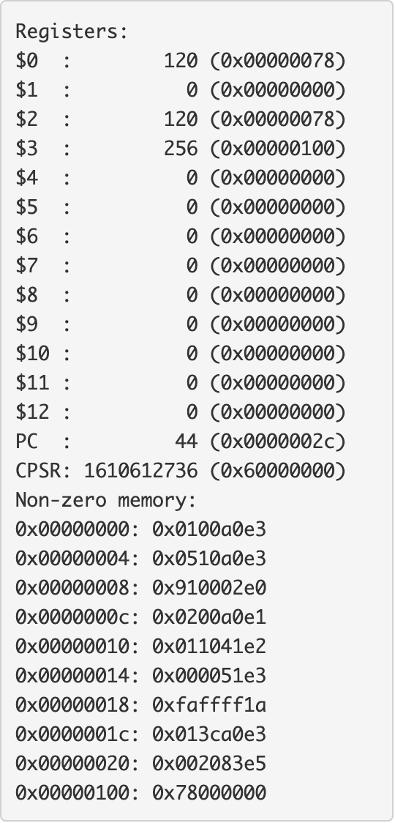
Implementation of Emulator
We had a C source file for each of the four ARM instructions and another source file which executes a general instruction.
A single C source file contained all the utility functions used for the emulator
emulate.c contained the main function, which loaded the binary object file and executed the ARM pipeline.

Slide 5
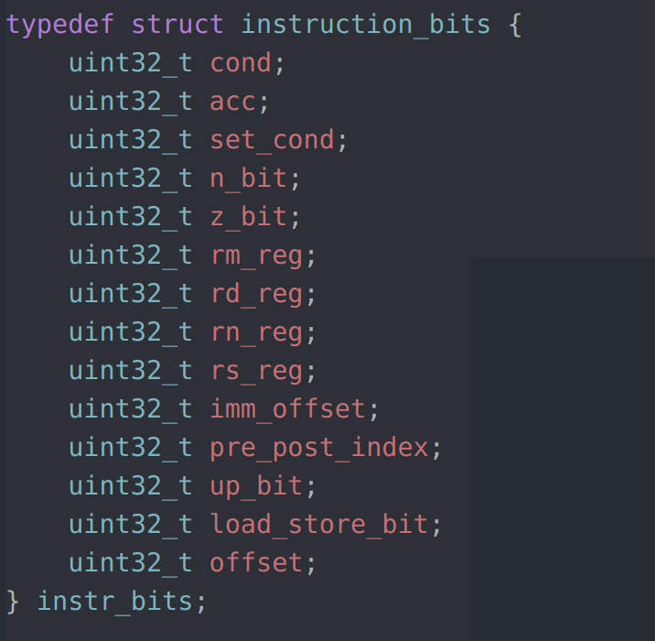
Structure
Used a structure to extract bits using slice function to easily use.
Inconsistency in program where this same procedure was done using two separate methods

Slide 6
Dependency Graph for Emulator

Slide 7
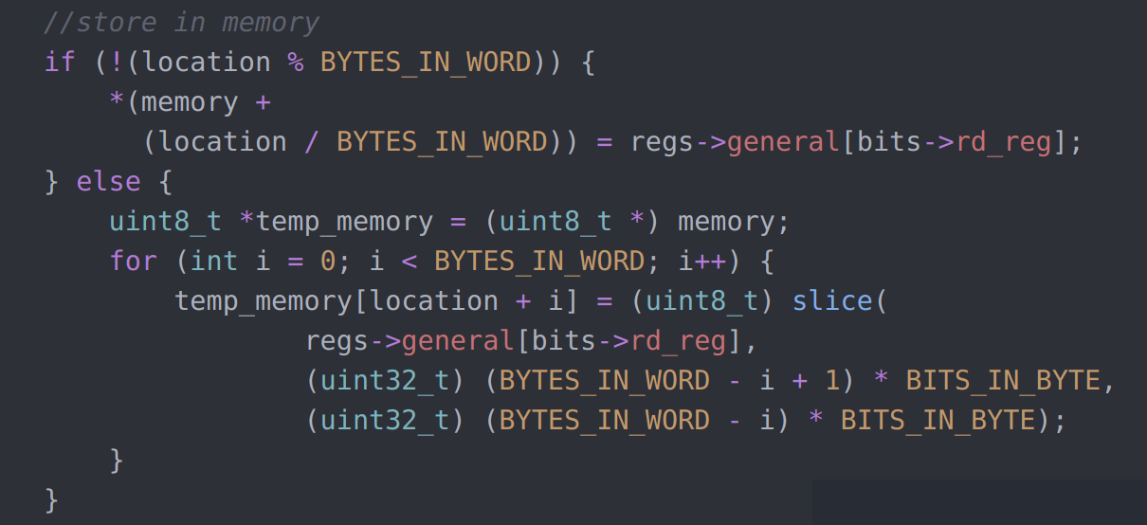
Issues
When dealing with tests which would manipulate memory in a position not beginning at the start of a 32 bit word, we would encounter failures
This was remedied by making memory temporarily byte addressable and assigning memory in individual bytes.

Slide 8
Part II: Assembler

Slide 9

Implementation of Assembler
As with the emulator, there was a C File that dealt with the encoding of each of the instructions. There was five instructions in the assembler with the addition of the special instruction.
A single C File with utility functions – e.g for helping create the symbol table during the first pass over the assembler file.
As advised by our mentor, we decided to abstract away assembler source files into a separate folder. We also did the same for emulator source files. Hence, the only C files in the src/ folder were assemble.c and emulate.c that contained the main functions. This led to a very clean project structure.

Slide 10
Implementation of Assembler
assemble.c contained the main function which performed the two pass over the assembly file and encoded the assembly instructions into a binary object file.
A single header file (assembler_structures.h) contained definitions of the data structures used such as the symbol table. Hence, there were 2 header files containing definitions, one for the emulator and one for the assembler. In the future, it may have been better to use a single global header file, containing definitions for both the assembler and the emulator.

Slide 11
Dependency Graph for Assembler

Slide 12
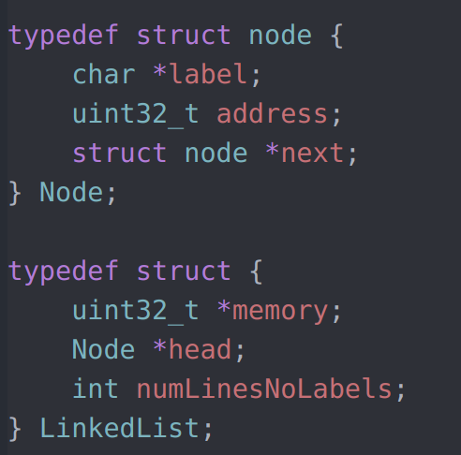
Linked List Structure
Structure made it simple to determine the position of labels in the instruction after the first initial pass, so when dealing with branch instructions we could correctly calculate the offset between the branch instruction and its label

Slide 13
Issues
Use of 'strtok' function. Function was causing many issues when debugging.
Branch instruction was incorrectly calculating the position of each label causing issues with any test which used branch. Issue was due to incorrect use of 'strtok' function.
Interpreting operand in an instruction was a bit of a hassle, however defining a separate function ('getOperandMask') to do this interpretation made it much simpler, including when the operand needed to be rotated.
Function reused many times across different instructions.

Slide 14
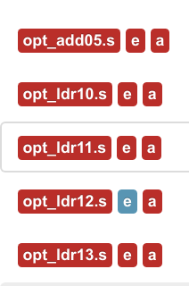
Optional Tests
Failing optional tests involving shifted registers.
In emulator, we believe there is an issue with our logic of how our carry bit is calculated for these cases, otherwise the implementation would appear correct.
In assembler, these cases should be straightforward to implement by extending our function which interprets the operand as an immediate value or a register by including a case for a shifted register.
However given time constraints we decided to focus on passing the main tests.

Slide 15
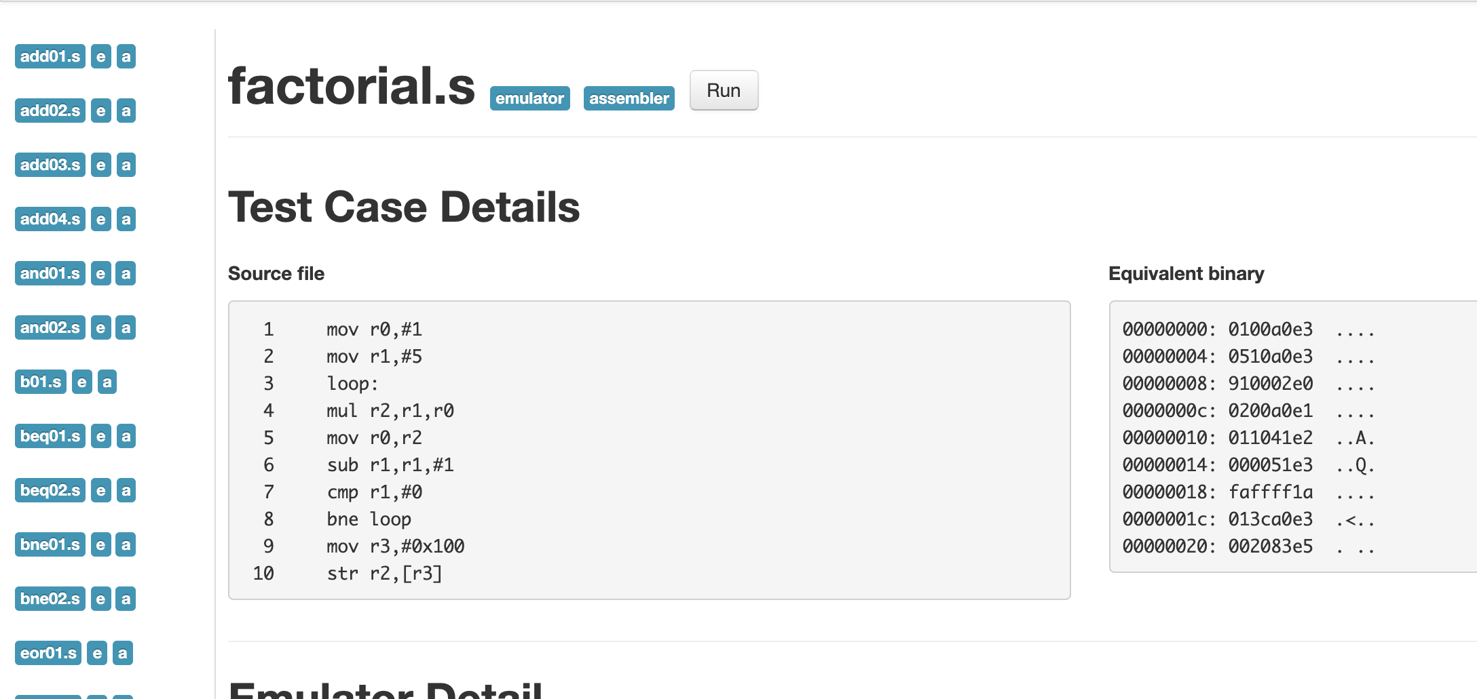
Review of Part I and Part II
Overall, as a group, we are very happy with the final result for Part I and II. We successfully met the criteria that was required, and our file structure and code were both very clean and concise.

Slide 16
Part III: Raspberry Pi

Slide 17
General Purpose IO on Raspberry Pi
For part III, we correctly assembled gpio.s into kernel.img. Replacing the Raspberry Pi's kernel with our assembled kernel.img successfully simulated the on and off of an LED on the Raspberry Pi Board.

Slide 18
Part IV: ZONA Chess Engine

Slide 19
Why?
We love the game of chess
We wanted a challenge that was difficult yet enjoyable
We wanted to bring our favourite physical board game into our own computerised version

Slide 20
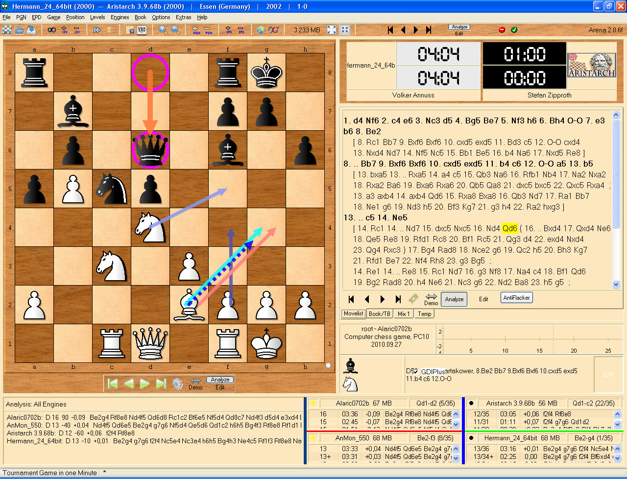
Arena
Arena Chess GUI is a Graphical User Interface (GUI) for chess.
Compatible with Winboard protocol and the UCI protocol.
In the ZONA Chess Engine, we have implemented the UCI protocol.

Slide 21
Features
We have implemented quite a few clever features which have really made the development phase easier and improved the performance of the ZONA Chess Engine.
Notable features include:
Bitboards
Array representation of the board
Implementation of UCI Protocol
‘Most Valuable Victim’ and ‘Least Valuable Aggressor’ heuristic
Quiescence Search
Notable mentions

Slide 22
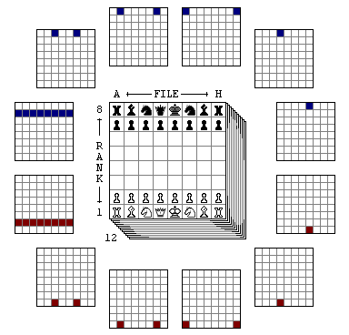
1. Bitboards
In the ZONA Chess Engine we made use of bit-boards.
Bitboards are specialisations of the bit array data structure, in which each bit represents a game position/state.
Bit boards have been useful due to how they optimise the speed, performance and memory usage in calculations.

Slide 23

2. Array Representation of Chess Board
In the ZONA Chess Engine we have represented the chess board as an array of size 120.
This representation of a chess board has proven to be greatly intuitive and useful throughout our project and works seamlessly with all the functions we have developed.

Slide 24
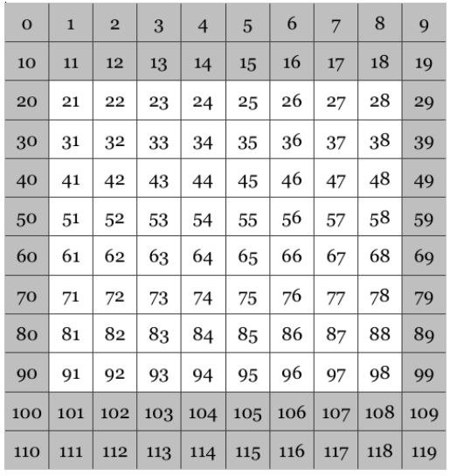
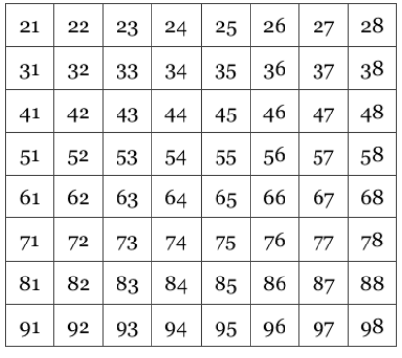
Figure 1: On left: 120-Board with ‘out of bounds’ squares (in grey) and ‘playable’ squares (in white). On right: 120-board with only showing ‘playable’ squares. 120-Board is stored as an array structure. The conversion between these two boards is defined as a function.

Slide 25
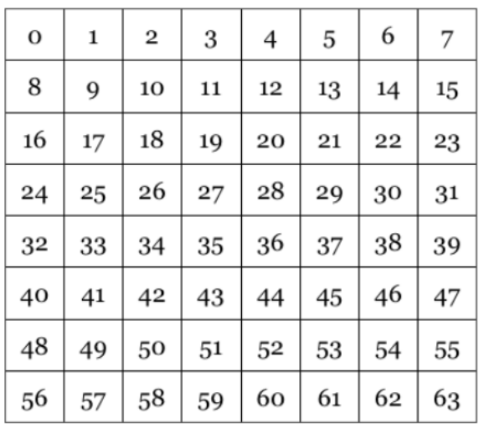
Figure 2: Conversion from ‘120-Board’ to ‘64-Board’ is done within the program. This is also stored as a function.

Slide 26
We don’t need two protective columns on the sides, simply because the board is an array which ‘wraps around’
Two protective off-board rows on the top and the bottom of the board

Slide 27
e.g. imagine there is a knight on 28. The knight moves in an L shape (2 right, 1 down)

Slide 28
e.g. imagine there is a knight on 28. The knight moves in an L shape (2 right, 1 down)

Slide 29
When it is at the end of the total board, it will go to the board square numbered 30.

Slide 30
Our chess engine therefore successfully detects all out of bounds move in an extremely simple and ingenious way using just an array structure.
The knight then moves 1 down to finish its move. It is still out of bounds, as it should be.

Slide 31
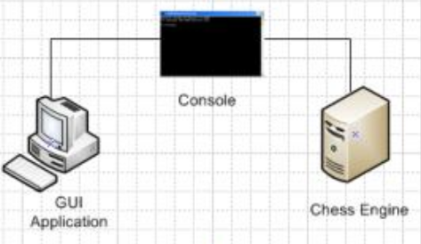
3. Implementation of UCI Protocol
UCI : Universal Chess Interface
Communicates with programs such as GUIs (Graphical User Interfaces).
Developed by Rudolf Huber and Stefan Meyer-Kahlen, released in November 2000
Diagram: https://www.slideserve.com/tara/adaptive-chess-program

Slide 32
The UCI Protocol
Enables communication between the graphical user interface and the ZONA Chess Engine.
UCI: players are called "white" and "black". Board squares are labelled a1 to h8, from lower left to upper right.
Pieces are "PNBRQKpnbrqk", where white pieces are upper case and black pieces are in lower case.
UCI Protocol chosen specifically over other possibilities (e.g. Chess Engine Communication Protocol)
Widely recognized
Understandable nomenclature and set of rules.
Supported by many graphical user interfaces
GUIs supporting UCI: Aquarium, Arena, Chess Assistant, ChessBase (Database), Chess for Android, ChessPartner, Chess Wizard, Cute Chess, Fritz GUI, HIARCS Chess Explorer, Jerry, jose, Kvetka, LittleBlitzer, PyChess ... (and many more)
List of GUIs supporting UCI: https://www.chessprogramming.org/UCI

Slide 33
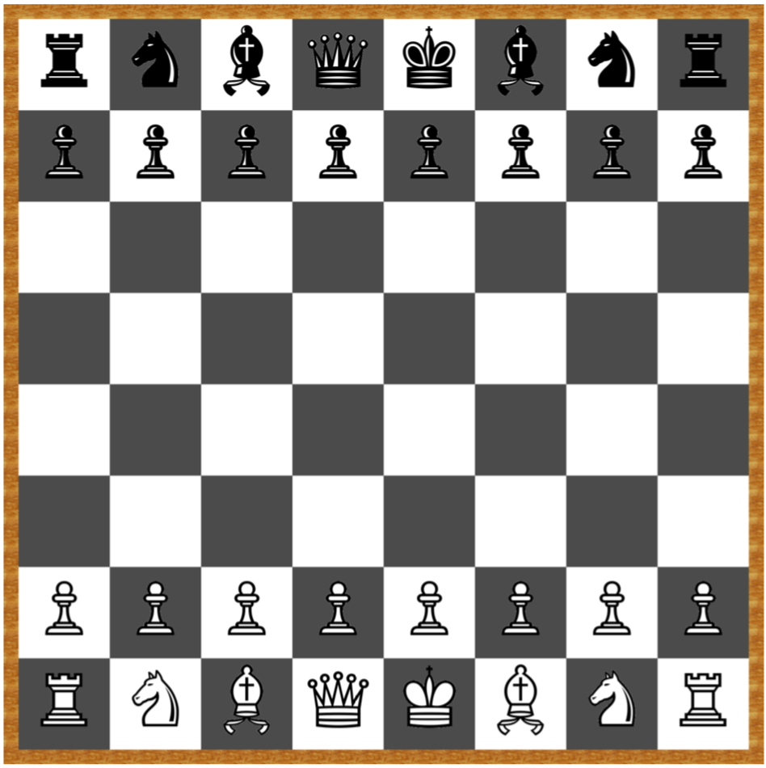
4. ‘Most Valuable Victim’ and ‘Least Valuable Aggressor’ heuristic
MVV/LVV (Most Valuable Victim/Least Valuable Aggressor) is a heuristic which generates or sort-captures moves in a reasonable order.
First it looks up the potential victim of all the attacked opponent pieces, in the order of the most valuable first, thus queen, rook, bishop, knight then pawn. After the most valuable victim is found, a cycle loops over the potential attackers that may capture the victim in reverse order, so from pawn, knight, bishop, rook, then queen.
So PawnxQueen is the most valuable, next comes KnightxQueen, BishopxQueen and so on down to QueenxPawn.

Slide 34

5. Quiescence Search
The ZONA Chess Engine, at the end of the main search, performs a more limited ‘quiescence search’, containing fewer moves.
Evaluates "quieter" positions and positions where no tactical moves can be made.
Stopping a search when desired depth is reached and then just simply evaluating is actually very dangerous.
e.g. QueenxPawn scenario

Slide 35
6. Notable mentions
MinMax
Alpha-Beta Search
History table to keep track of moves (leading to ‘take_back_move’ function which may undo a move)

Slide 36
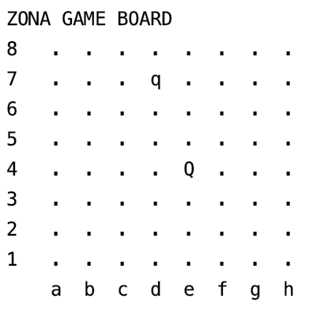
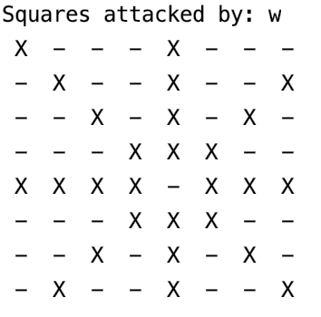
Demonstration 1: Correctly Calculating Attacks
Image on far right: https://www.quora.com/Can-a-queen-move-like-a-knight

Slide 37
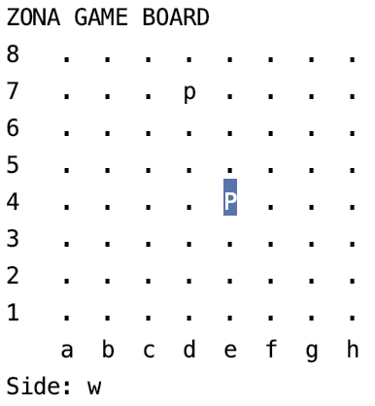
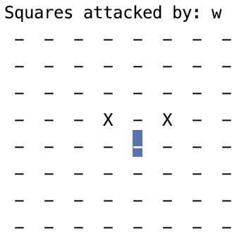
Demonstration 1: Correctly Calculating Attacks
Image on far right: https://www.quora.com/Can-pawns-attack-forward-in-chess

Slide 38
Chess Piece Promotion
When a pawn reaches the opposite side of the board, it promotes. The pawn can be replaced by a queen, a rook, a knight, or a bishop of the same colour.

Slide 39
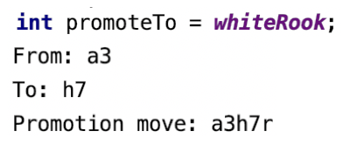
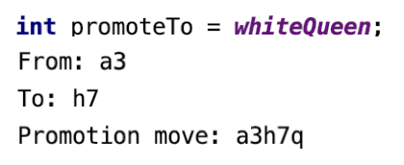
Demonstration 2: Promoting Pawn
In the code, forced a promotion to a white rook and ran the promotion function. Output of ‘r’ at end of move has confirmed it has promoted to a rook.
In the code, forced a promotion to a white queen and ran the promotion function. Output of ‘q’ at end of move has confirmed it has promoted to a queen.

Slide 40
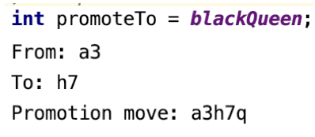
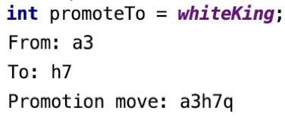
Demonstration 2: Promoting Pawn
Ignored the colour of the piece defined in the ‘promoteTo’ variable as intended. Output of ‘q’ at end of move has confirmed it has promoted to a queen.
It is not possible to promote to a king. ZONA automatically caps the promotion at a queen as you can see by the ‘q’

Slide 41
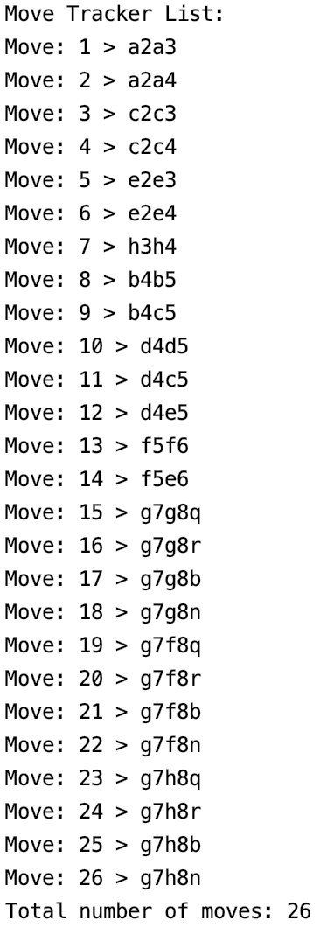
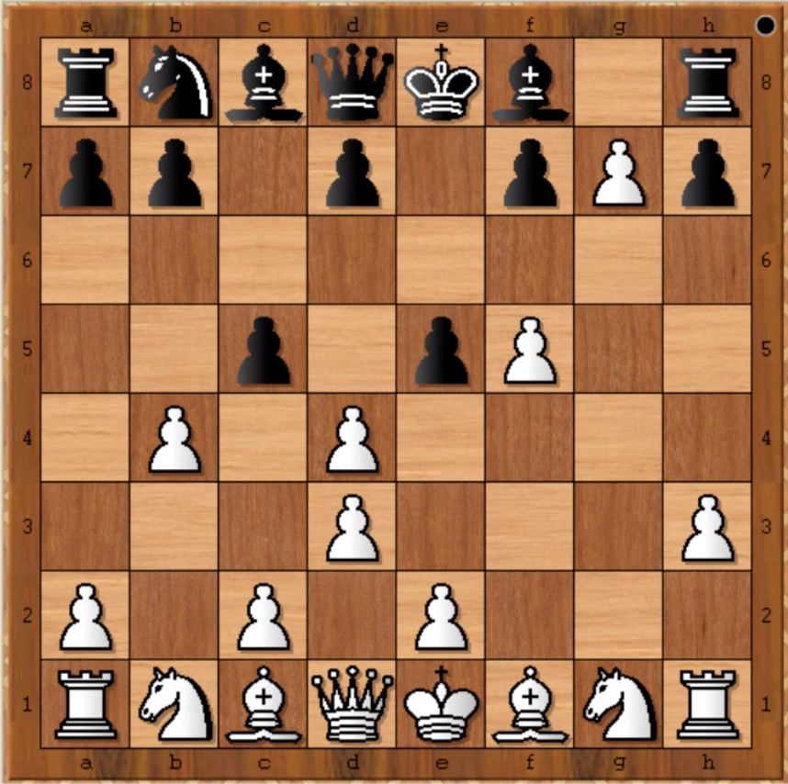
Demonstration 3: Generating All Moves

Slide 42
= rnbqkb1r/pp1p1pPp/8/2p1pP2/1P1P4/3P3P/P1P1P3/RNBQKBNR w KQkq e6 0 1"

Slide 43
All white pawn moves
Pawn at d4 can either move up to d5 or attack the black pawn at c5 or attack the black pawn at e5.

Slide 44
All white pawn moves
Pawn a2 can move two spaces up to a4 as pawns can always move 2 spaces on their first go.
Pawn a2 can move one space up to a3

Slide 45
All white pawn moves
Pawn at g7 can promote in various different ways.

Slide 46
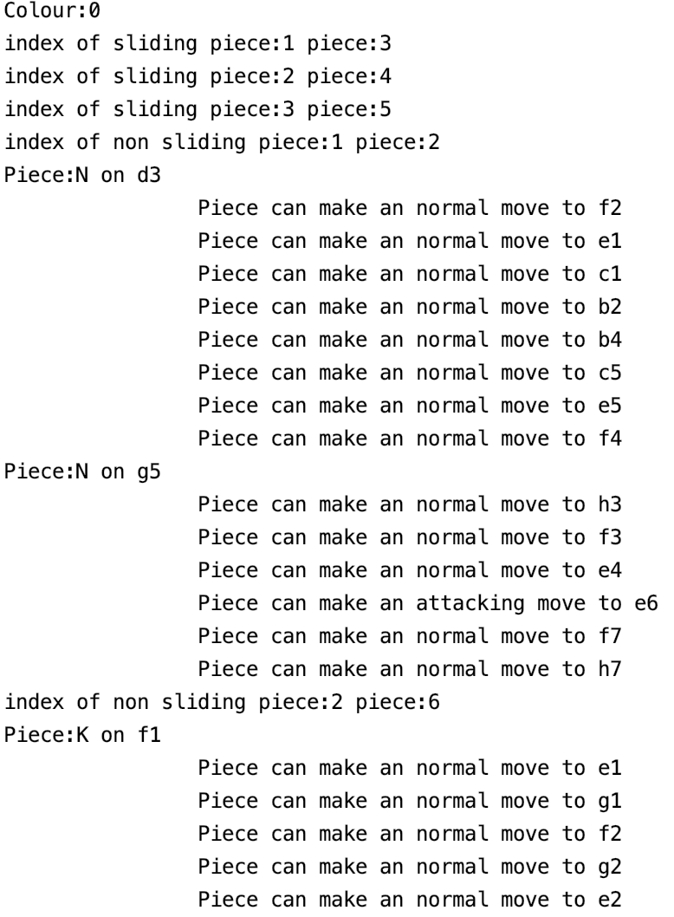
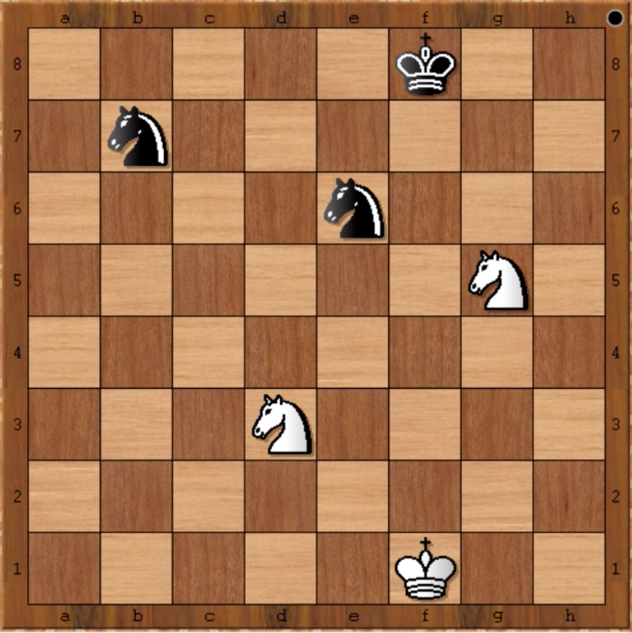
Demonstration 4: Identifying Moves

Slide 47
Colour: 0 means that it is detecting the white
pieces possible moves at the moment

Slide 48
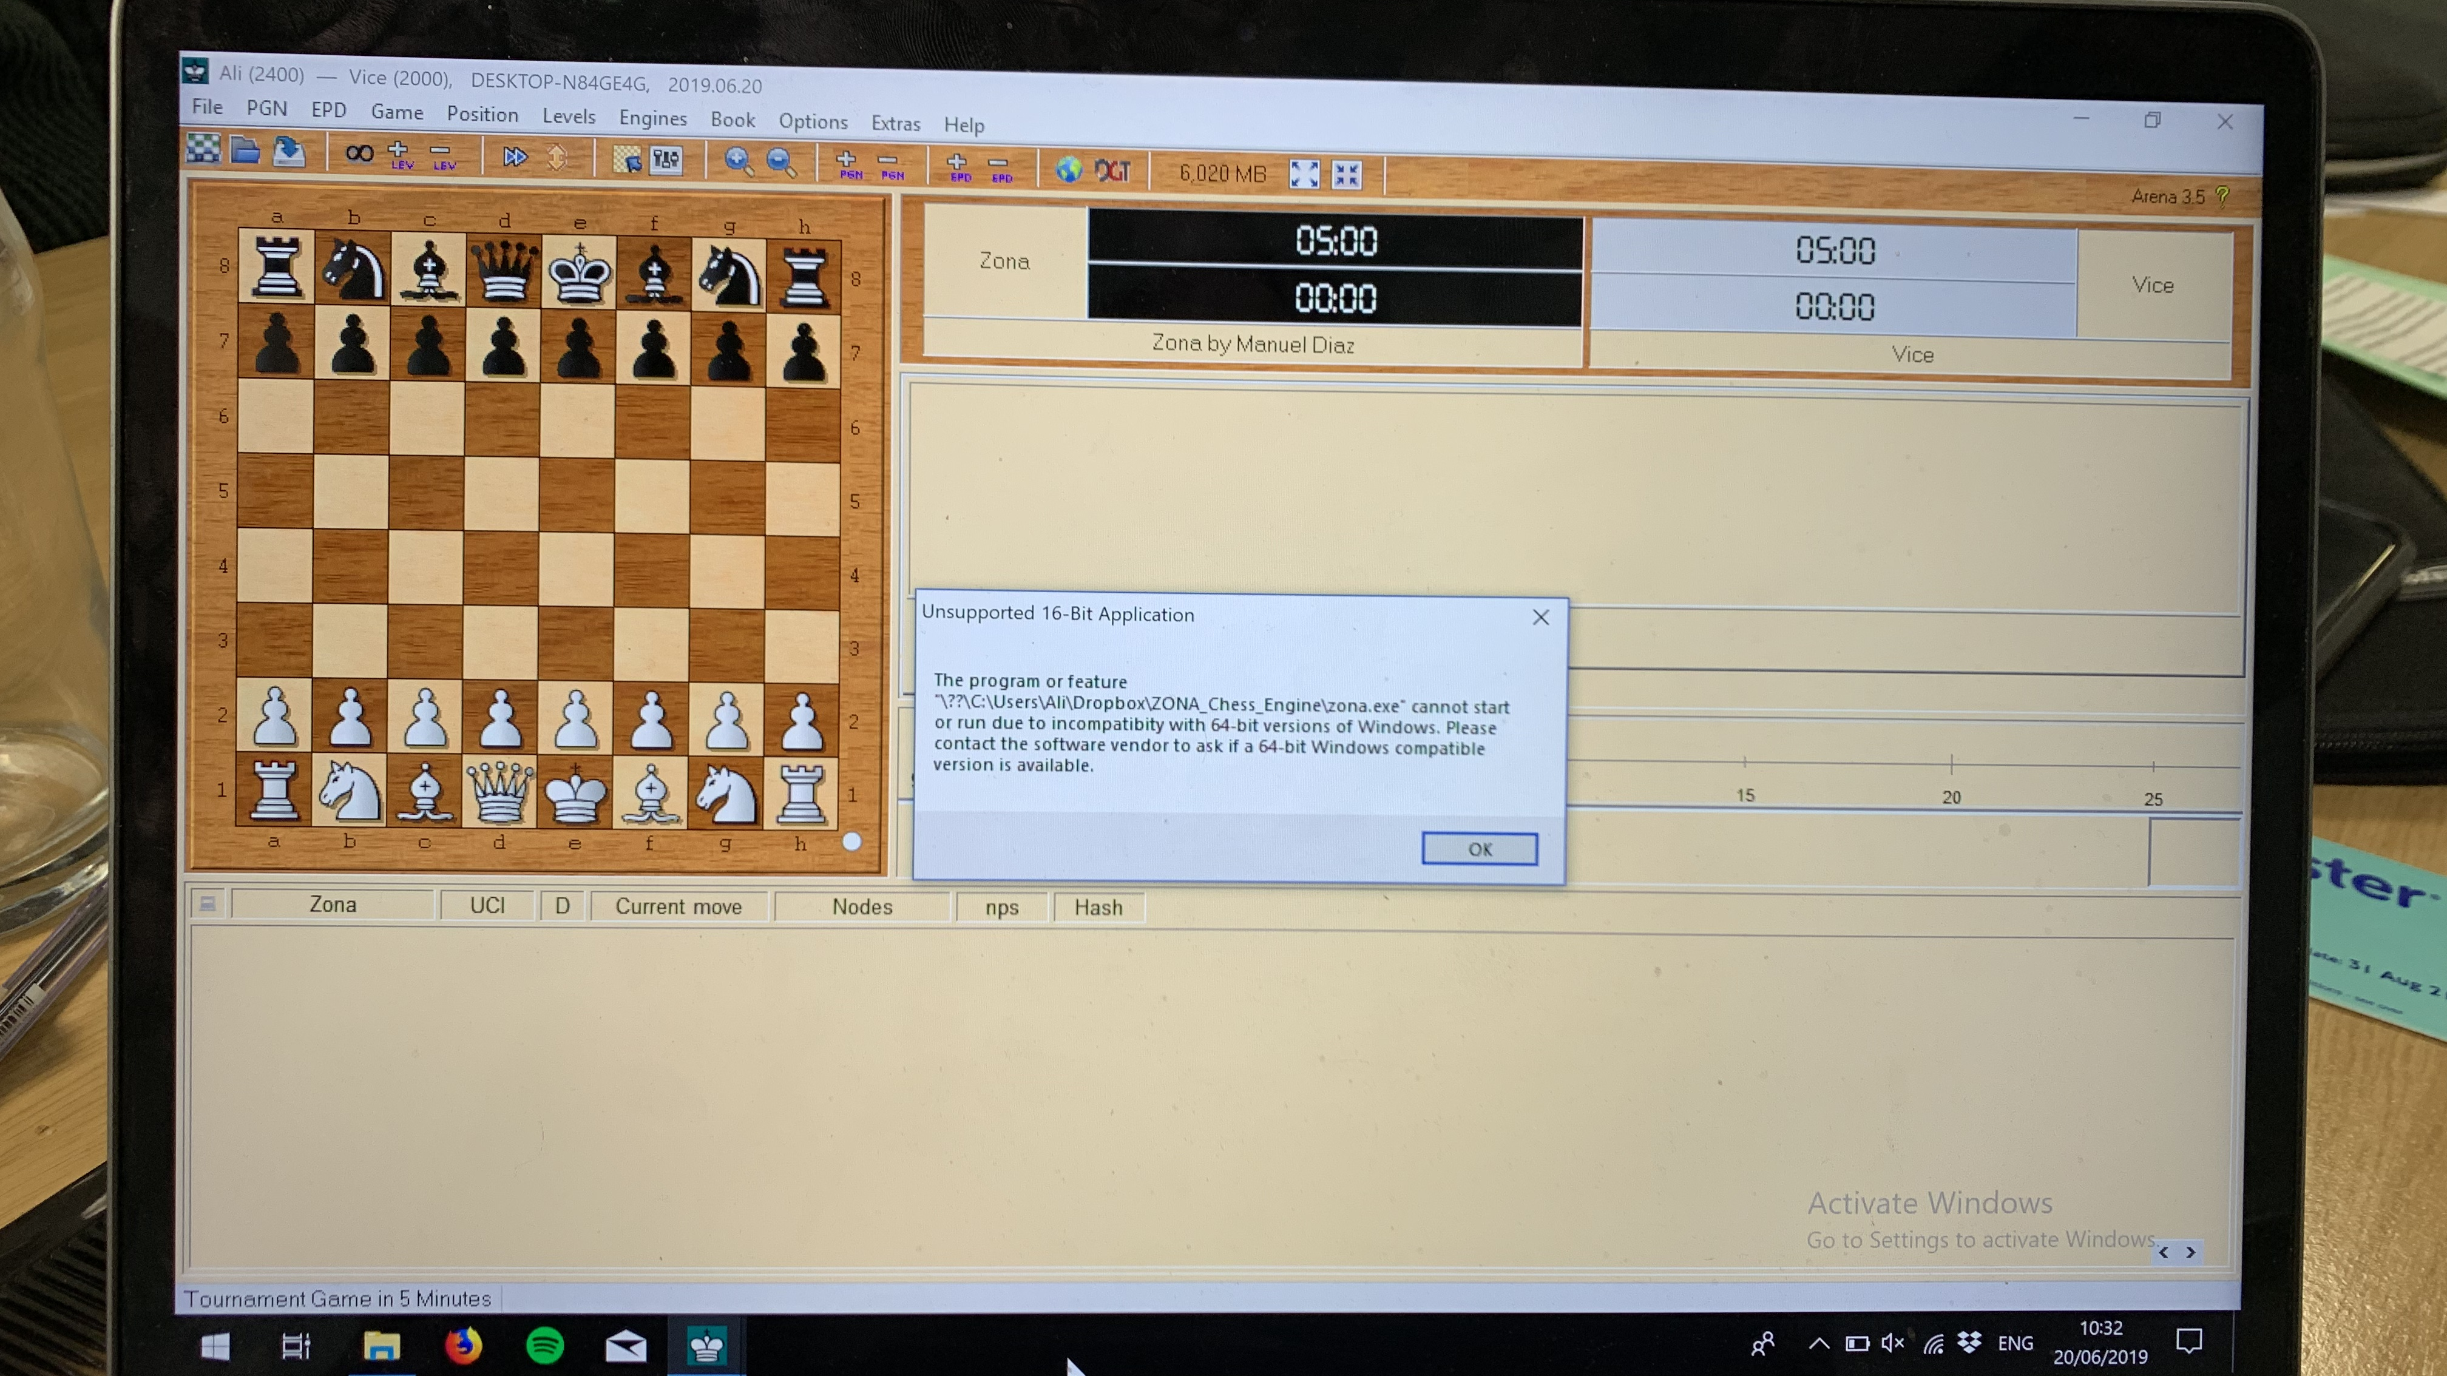
Unfortunately…

Slide 49
Testing
Various tests
Different values and FEN setups used
We are very pleased with the outcome!

Slide 50

Group Reflection

Slide 51
What went well?
Overall, we worked very well as a team. Communication within group members was extremely good and is one of the main reasons for the successful completion of the project.
One skill that all our team members greatly developed was taking the time to efficiently plan before jumping on a PC and writing code.
We also become good at time-management. There were a lot of little deadlines during this project and we made sure we did not lag behind any of them.
We believe that we now can all program in C quite proficiently.

Slide 52
Improvements for Future
We underestimated the importance of Git when programming with peers. Initially, we ran into quite a few problems with pushing and pulling, with the different branches.
At the end of project, we had to refactor a lot of code. This is because of our approach to fix everything at the end. In future projects, we have to enforce good code style from right at the beginning and as a group, follow a consistent code style.

Slide 53
Conclusion
For future projects, we would like our group to have the same enthusiasm and perseverance that was exhibited during this project. All group members channelled their individual skills into the appropriate places, whether that was leading the development and testing of the extension or making sure that the code was as clear as possible and adhered to good programming practices.
A significant thing our group learned during this project is the importance of testing. Although, we were testing our code extensively throughout the project, we were doing this all manually. We have now realised that automating tests is extremely invaluable and time-efficient, e.g we could have added the relevant commands to our Makefile, so every time we call ‘make’ we are not only compiling our program but also testing it.

Slide 54
Thank you for listening.

